Slide 1


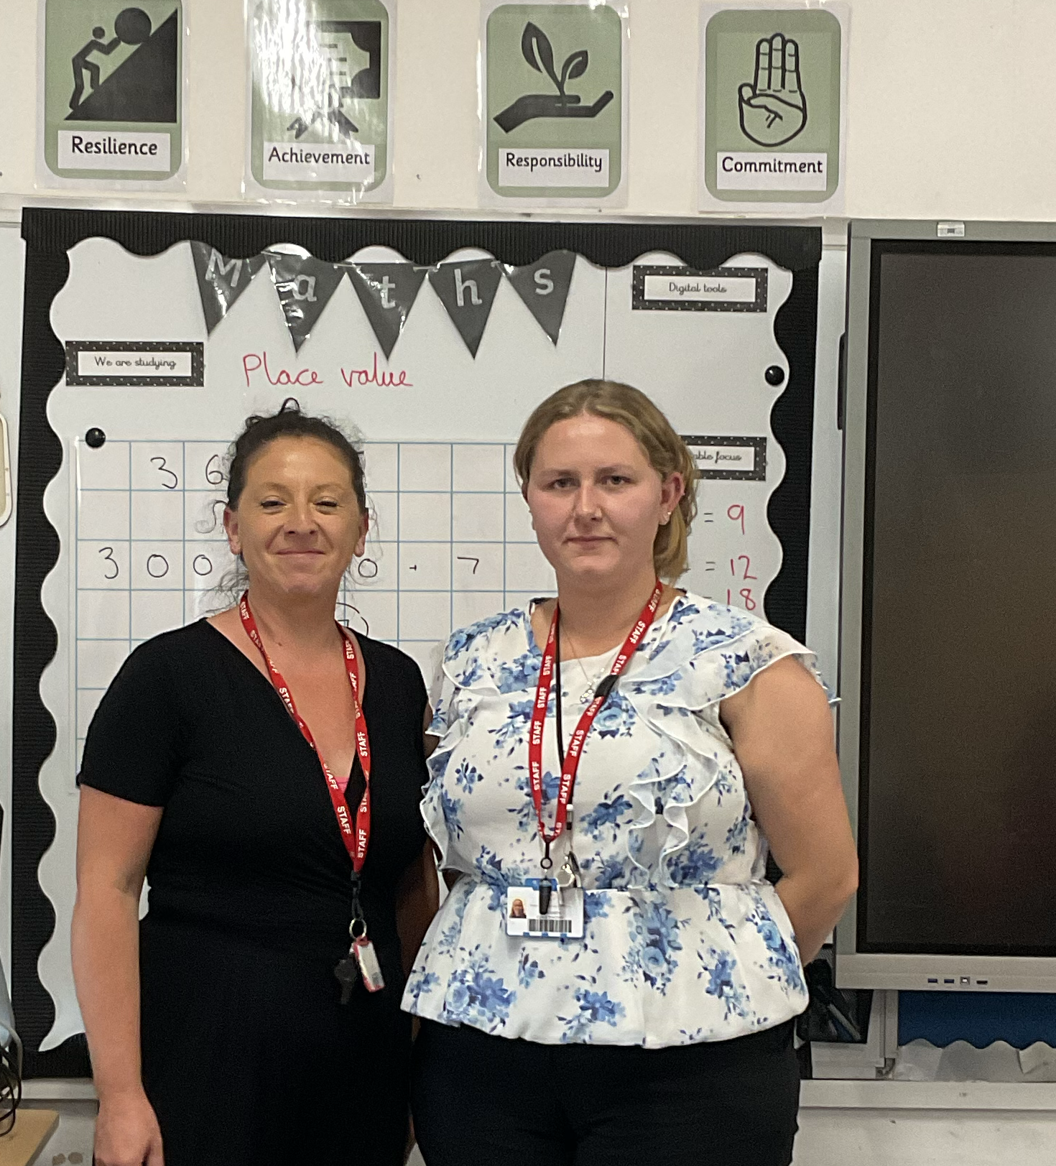
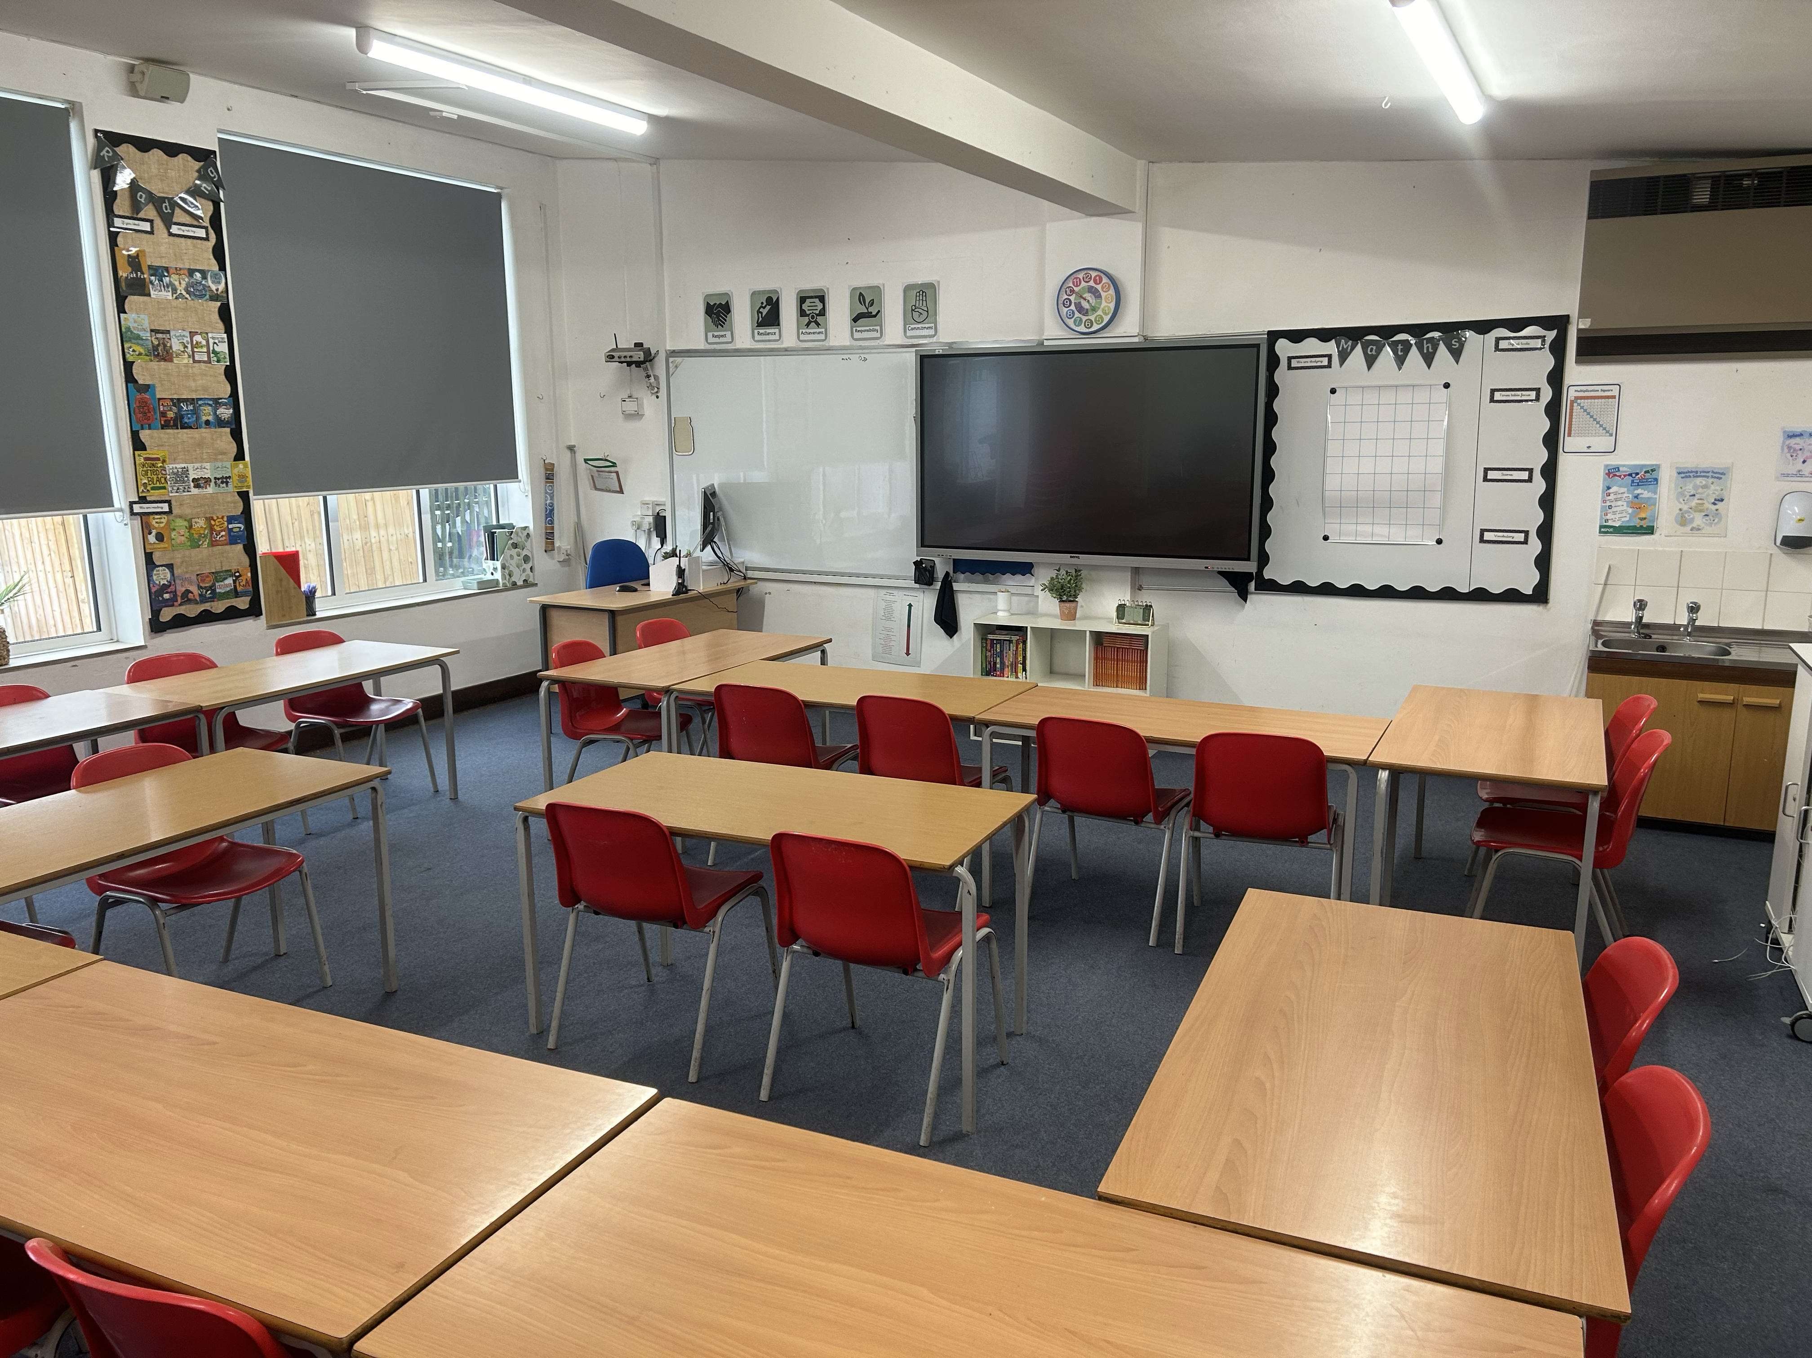
Deer CLASS
Newsletter
Autumn 2024
Maths
We follow White Rose across the school. Our areas of focus are:
Place Value
Addition and Subtraction
Area
Multiplication and division
Maths Essentials
If you can practice the below skills with your child, it will really help with their maths:
Adding with exchanges
Subtracting with exchanges
All multiplication tables
Welcome to the Autumn Term.
Welcome back and welcome to your new class…. Deer!
I hope you have all had a wonderful summer holidays and are fully rested for the busy term ahead. Both Miss Platt and myself are very excited to be working with you this year and I hope everyone will settle into year 4 and enjoy the lessons that are to come.
English
English Writing:
Across the year we visit each module twice, with each having an ‘A’ and a ‘B’ block:
Poems A
Persuasive writing A
First person diary entries A
Third person adventure stories A
Newspaper reportsA
English Reading
The queen’s nose
The girl who stole the elephant
Outdoor Clothes
Where possible all playtimes will be on the field. As the weather changes please ensure your child has wellies in school and a waterproof coat every day. Please also keep a spare pair of socks and underwear in your child’s bag just in case!
Key Dates
28th October-8th November : Half Term
Tuesday 17th December: Y1/2 Christmas Play (2pm & 4pm TBC)
Friday 20th December: End of Term
.

Slide 2
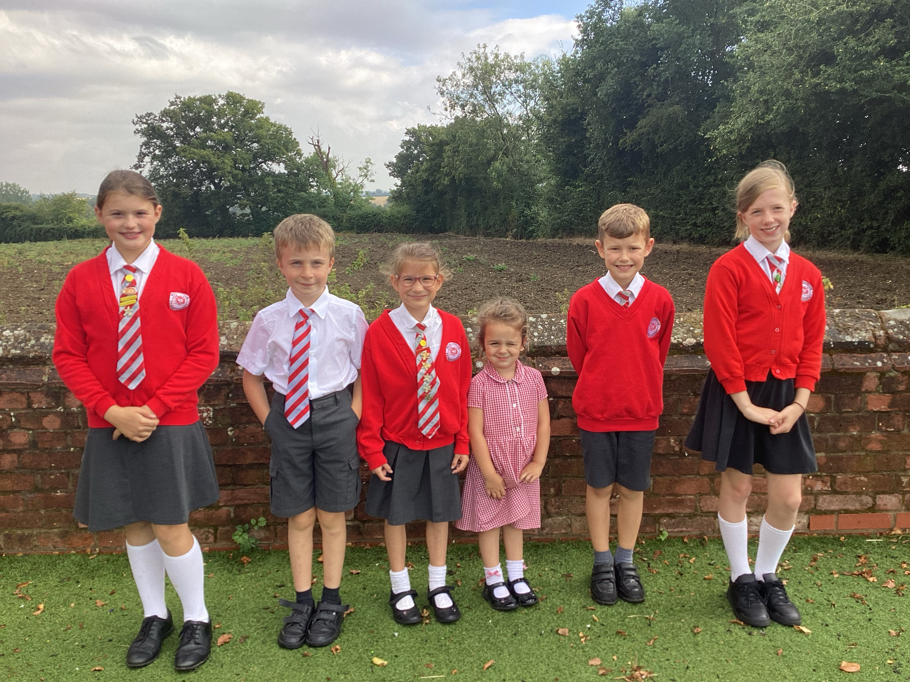

More of our Autumn Learning:
Science
Living things and their habitats
History/Geography:
Anglo Saxon Kingdoms
Rivers
Art & Design / DT:
Drawing, Painting /
Food and nutrition
Music:
Singing Focus:
Untuned Percussion:
RE:
Judaism
Christianity
Computing:
Ebook creative storyboarding
PSHE
Our first Jigsaw Pieces are:
Being Me in My World
'Who am I and how do I fit?’
Celebrating Difference
Respect for similarity and difference. Anti-bullying and being unique
PE
Our school PE day is Wednesday. Please send children in PE kit* every Wednesday for the whole day. This term we will have 6 sessions of gymnastics with Hannah on 9th 16th&23rd Oct and 4th , 11th & 18th Dec. Remaining weeks are PE with class teacher.
Our second PE session will be on a Friday afternoon. Please send children in wearing uniform on Fridays and bring PE Kit to change into, children will go home wearing PE Kit.
*PE UNIFORM: Plain red t-shirt or a red polo t-shirt, plain black shorts, skorts or tracksuit (all with or without school logo), black or white trainers, leotards for gymnastics (optional).
Homework
Children will be set a list of 10 spellings to learn, these will be set on a Friday and children will be tested the following Friday. In addition to this, they will also be sent home some multiplication precision grids to help with times tables they need to practice.
Reading at Home – The Wickhambrook Way
Each week, we expect all children to read 4 times at home for 10 minutes.
Please record in your child’s reading record every time you read with them.
All reading and phonics books and reading records must be in school every day to allow staff to read with your child and monitor their home support..

